Slide 1

Lecture On:
Acoustic Metamaterials
Ryan Hill

Slide 2
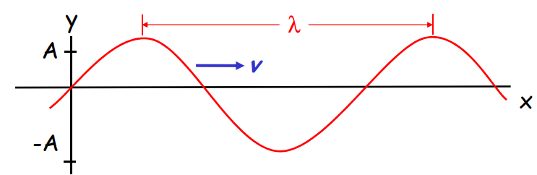
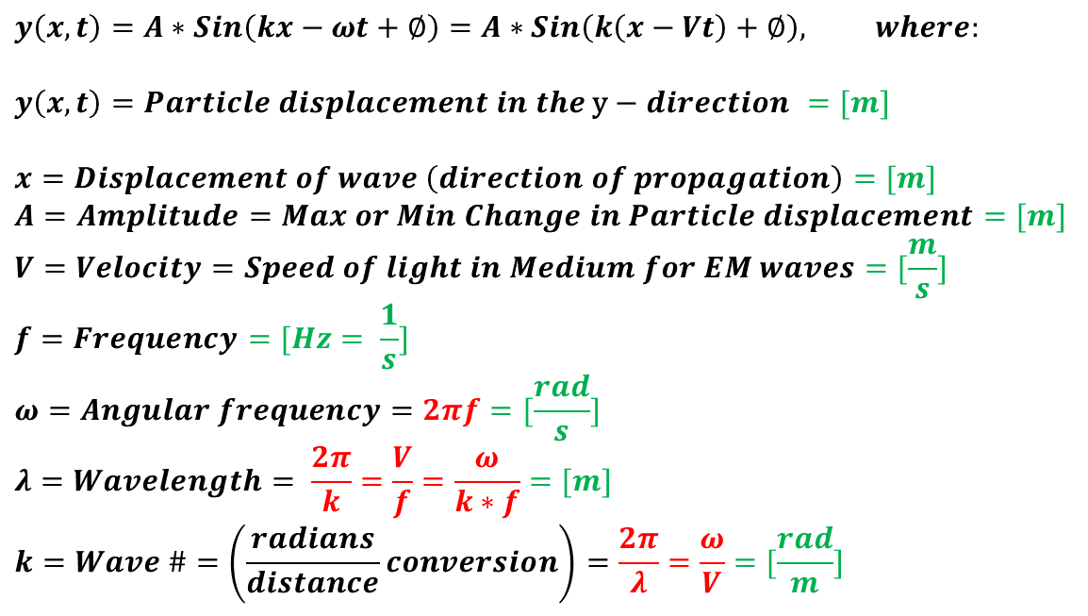
Types of Waves – Transverse Wave
$$y\left(x,t\right)=A∗Sin\left(kx−ωt+∅\right)=A∗Sin\left(k\left(x−Vt\right)+∅\right), where:$$
$$y\left(x,t\right)=Particle displacement in the \text{y}−direction =[m]$$
$$x=Displacement of wave \left(direction of propagation\right)=[m]$$
$$A=Amplitude=Max or Min Change in Particle displacement=[m]$$
$$V=Velocity=Speed of light in Medium for EM waves=[\frac{m}{s}]$$
$$f=Frequency=[Hz= \frac{1}{s}]$$
$$ω=Angular frequency=2πf=[\frac{rad}{s}]$$
$$λ=Wavelength= \frac{2π}{k}=\frac{V}{f}=\frac{ω}{k∗f}=[m]$$
$$k=Wave \#=\left(\frac{radians}{distance}conversion\right)=\frac{2π}{λ}=\frac{ω}{V}=[\frac{rad}{m}]$$

Slide 3
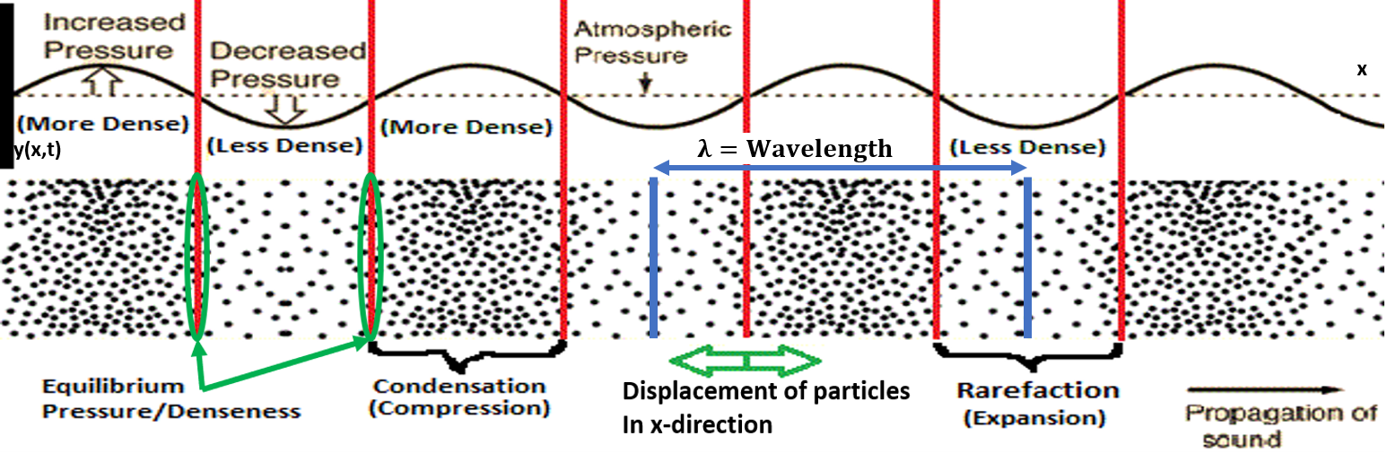
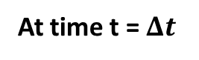
Types of Waves – Sound Pressure (Longitudinal) Wave
No mean particle displacement
The sound wave oscillates the particles back and forth
Increasing Pressure leads to increasingly dense particles
Decreasing Pressure leads to decreasingly dense particles
Equilibrium Pressure is Atmospheric Pressure
At time t = 0
At time t = $Δt$
http://hyperphysics.phy-astr.gsu.edu/hbase/Sound/tralon.html

Slide 4
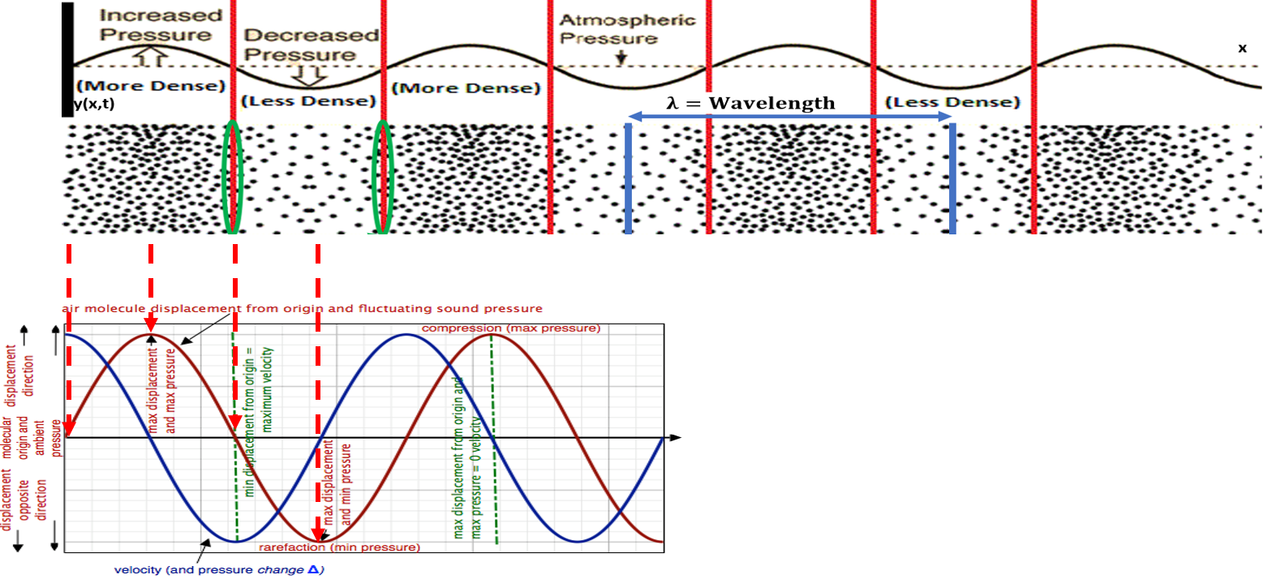
Types of Waves – Sound Pressure (Longitudinal) Wave
http://www.indiana.edu/~emusic/etext/acoustics/chapter1_sound3.shtml

Slide 5
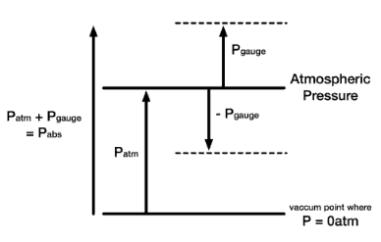
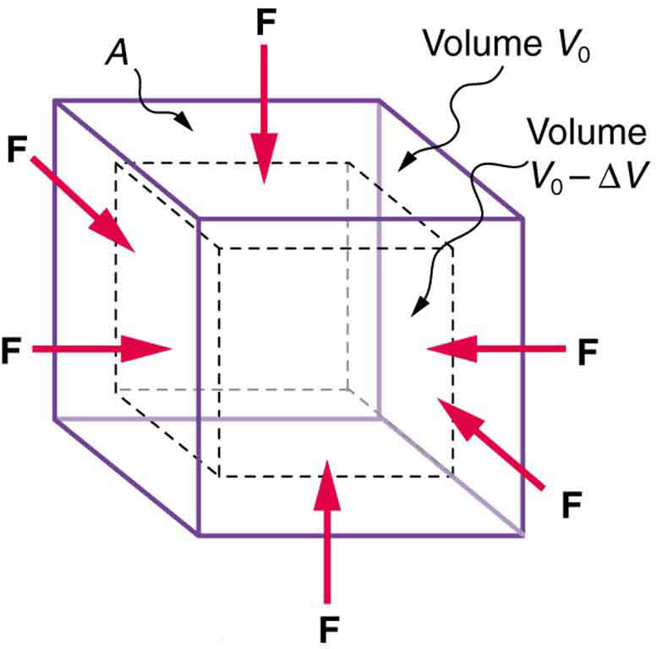
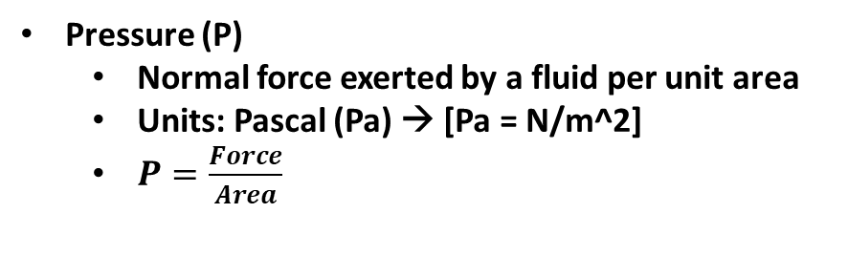
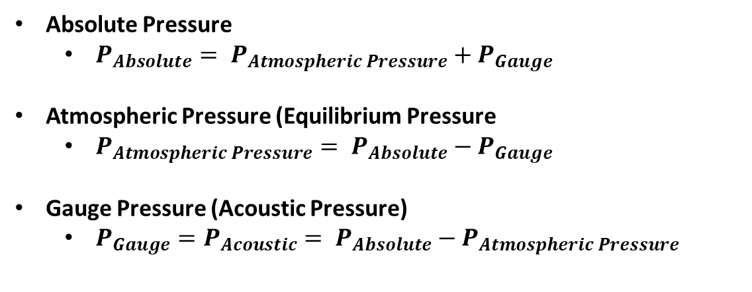
What is Pressure?
Pressure (P)
Normal force exerted by a fluid per unit area
Units: Pascal (Pa) → [Pa = N/m^2]
$P=\frac{Force}{Area}$
Absolute Pressure
$P_{Absolute}= P_{Atmospheric Pressure}+P_{Gauge}$
Atmospheric Pressure (Equilibrium Pressure
$P_{Atmospheric Pressure}= P_{Absolute}−P_{Gauge}$
Gauge Pressure (Acoustic Pressure)
$P_{Gauge}=P_{Acoustic}= P_{Absolute}−P_{Atmospheric Pressure}$
Force
Force
Pressure
Greater
(Less Area)
Pressure
Less
(More Area)
https://www.nuclear-power.net/nuclear-engineering/thermodynamics/thermodynamic-properties/what-is-pressure-physics/

Slide 6
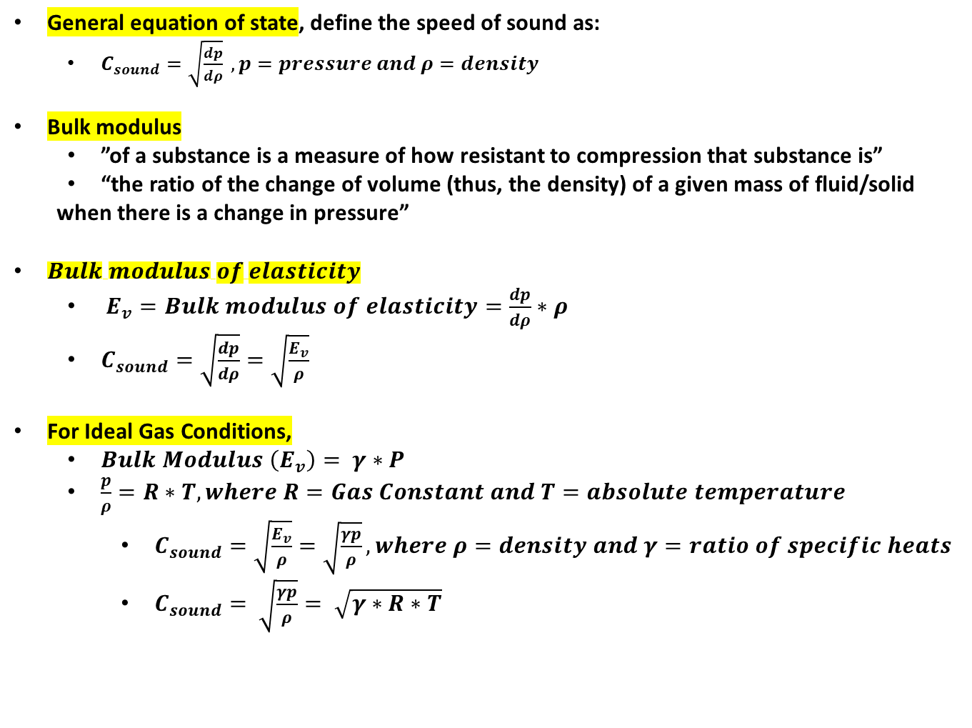
C (Speed of Sound of Gases)
General equation of state, define the speed of sound as:
$C_{sound}=\sqrt{\frac{dp}{dρ}} , p=pressure and ρ=density$
Bulk modulus
”of a substance is a measure of how resistant to compression that substance is”
“the ratio of the change of volume (thus, the density) of a given mass of fluid/solid
when there is a change in pressure”
$Bulk modulus of elasticity$
$E_{v}=Bulk modulus of elasticity=\frac{dp}{dρ}∗ρ$
$C_{sound}=\sqrt{\frac{dp}{dρ}}=\sqrt{\frac{E_{v}}{ρ}}$
For Ideal Gas Conditions,
$Bulk Modulus \left(E_{v}\right)= γ∗P$
$\frac{p}{ρ}=R∗T, where R=Gas Constant and T=absolute temperature$
$C_{sound}=\sqrt{\frac{E_{v}}{ρ}}=\sqrt{\frac{γp}{ρ}}, where ρ=density and γ=ratio of specific heats$
$C_{sound}= \sqrt{\frac{γp}{ρ}}= \sqrt{γ∗R∗T}$
Temperature dependent
https://nigerianscholars.com/tutorials/friction-drag-elasticity/changes-in-volume-bulk-modulus/

Slide 7
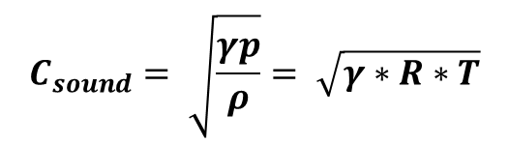
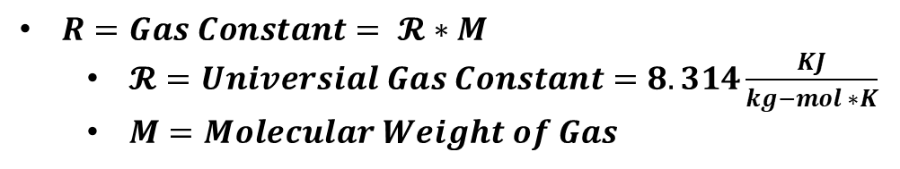
C (Speed of Sound of Gases)
Humidity (H)
is the amount of water vapor (gas) in the air.
Relative Humidity (RH)
is the amount of water vapor in the air to the total amount of water vapor that be held in the air at a temperature
“ is the ratio of the partial pressure of water vapor to the equilibrium vapor pressure of water at a given temperature”
$R=Gas Constant= 𝓡∗M$
$𝓡=Universial Gas Constant=8.314\frac{KJ}{kg−mol ∗K}$
$M=Molecular Weight of Gas$
How does the value of Humidity change the Molecular Weight?
Humidity dependent
$$C_{sound}= \sqrt{\frac{γp}{ρ}}= \sqrt{γ∗R∗T}$$
Temperature dependent

Slide 8
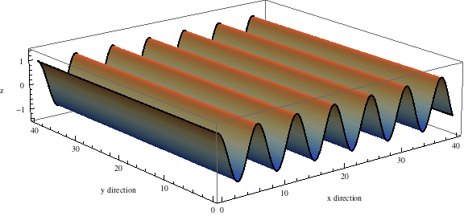
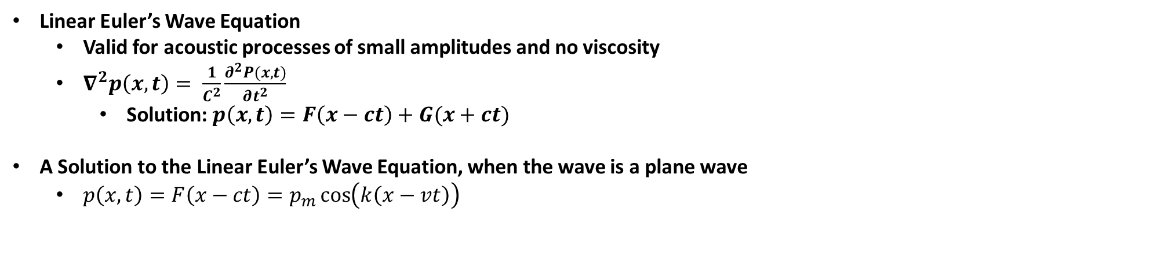
Linear Euler Wave Equation
Linear Euler’s Wave Equation
Valid for acoustic processes of small amplitudes and no viscosity
$∇^{2}p\left(x,t\right)= \frac{1}{C^{2}}\frac{∂^{2}P(x,t)}{∂t^{2}}$
Solution: $p\left(x,t\right)=F\left(x−ct\right)+G(x+ct)$
A Solution to the Linear Euler’s Wave Equation, when the wave is a plane wave
$p\left(x,t\right)=F\left(x−ct\right)=p_{m}\cos\left(k\left(x−vt\right)\right)$
Plane Wave

Slide 9
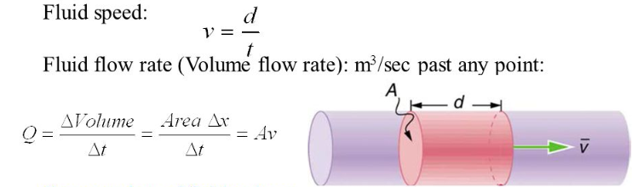
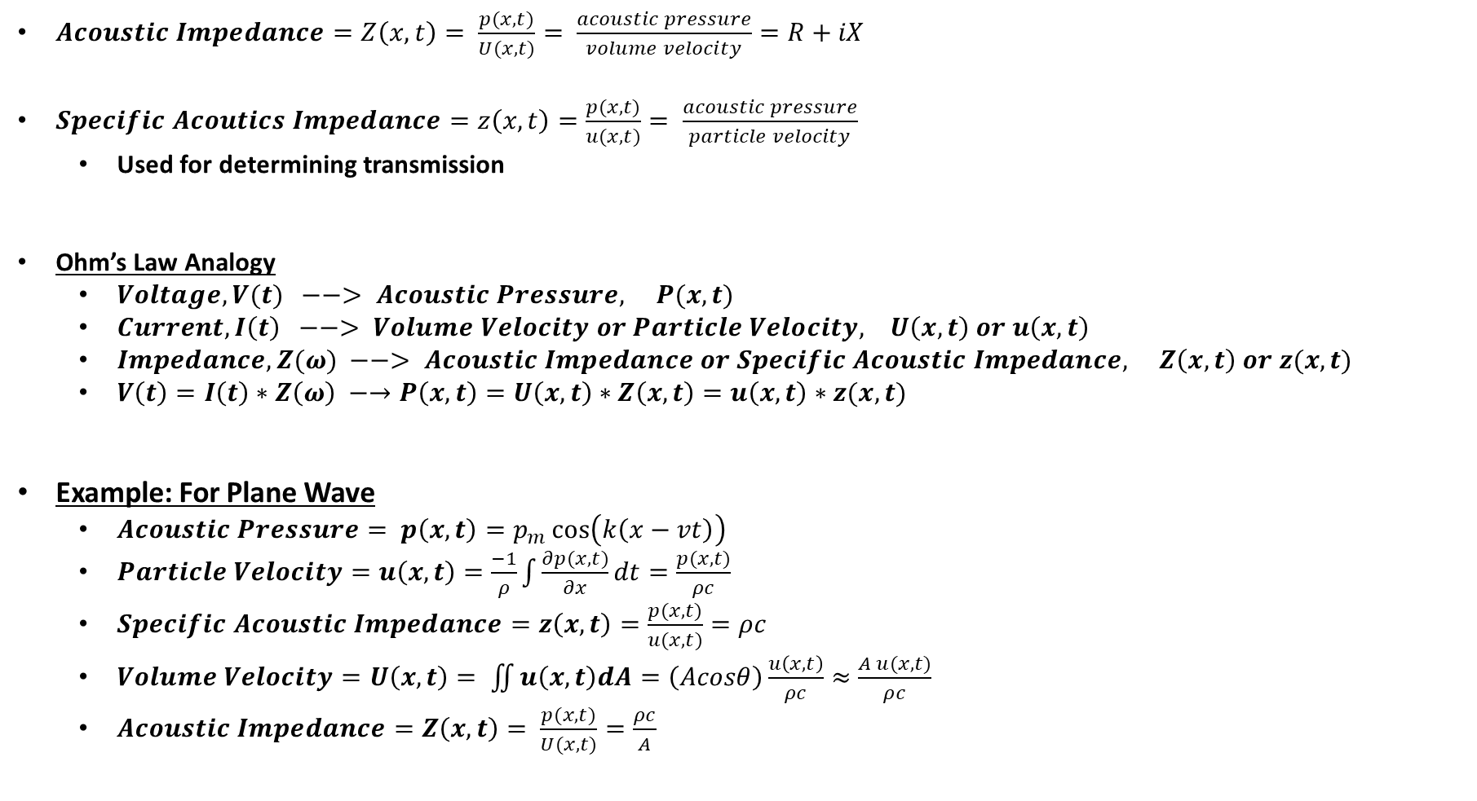
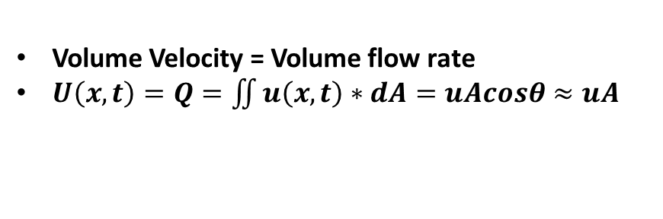
Pressure, Velocity, and Impedance (Ohm’s Law Equivalent)
$Acoustic Impedance=Z\left(x,t\right)= \frac{p(x,t)}{U(x,t)}= \frac{acoustic pressure}{volume velocity}=R+iX$
$Specific Acoutics Impedance=z\left(x,t\right)=\frac{p(x,t)}{u(x,t)}= \frac{acoustic pressure}{particle velocity}$
Used for determining transmission
Ohm’s Law Analogy
$Voltage, V(t) −−> Acoustic Pressure, P(x,t)$
$Current, I\left(t\right) −−> Volume Velocity or Particle Velocity, U\left(x,t\right) or u\left(x,t\right)$
$Impedance, Z(ω) −−> Acoustic Impedance or Specific Acoustic Impedance, Z\left(x,t\right) or z(x,t)$
$V\left(t\right)=I\left(t\right)∗Z\left(ω\right) −→P\left(x,t\right)=U\left(x,t\right)∗Z\left(x,t\right)=u\left(x,t\right)∗z(x,t)$
Example: For Plane Wave
$Acoustic Pressure= p\left(x,t\right)=p_{m}\cos\left(k\left(x−vt\right)\right)$
$Particle Velocity=u\left(x,t\right)=$ $\frac{−1}{ρ}\int{\frac{∂p(x,t)}{∂x}dt}=\frac{p(x,t)}{ρc}$
$Specific Acoustic Impedance=z\left(x,t\right)=\frac{p(x,t)}{u(x,t)}=ρc$
$Volume Velocity=U\left(x,t\right)= \iint{u\left(x,t\right)dA}=\left(Acosθ\right)\frac{u\left(x,t\right)}{ρc}≈\frac{A u(x,t)}{ρc}$
$Acoustic Impedance=Z\left(x,t\right)= \frac{p(x,t)}{U(x,t)}=\frac{ρc}{A}$
Volume Velocity = Volume flow rate
$U\left(x,t\right)=Q=\iint{u\left(x,t\right)}∗dA=uAcosθ≈uA$
https://slideplayer.com/slide/8336241/

Slide 10
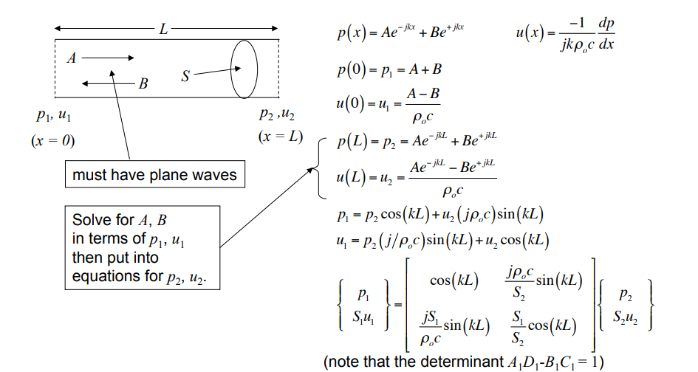
Acoustic Transmission Line Model
https://mycourses.aalto.fi/pluginfile.php/395000/mod_resource/content/1/Lecture10.pdf

Slide 11
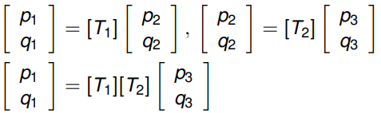

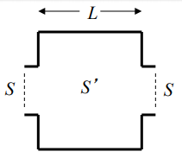
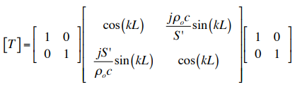
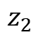
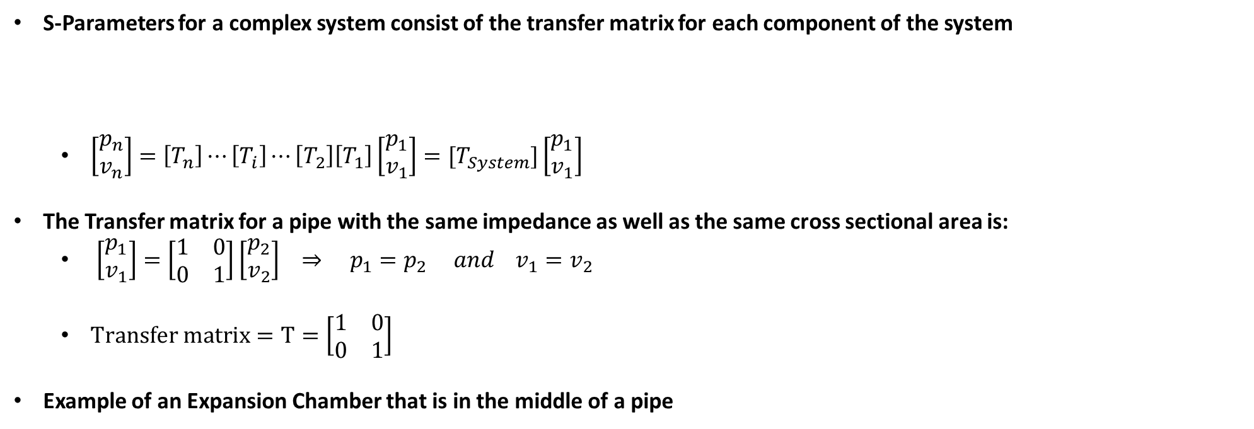

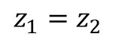
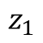
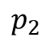
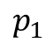
S-Parameters (Complex Systems)
S-Parameters for a complex system consist of the transfer matrix for each component of the system
$\left[\begin{matrix}p_{n} \\ v_{n}\end{matrix}\right]=\left[T_{n}\right]⋯\left[T_{i}\right]⋯\left[T_{2}\right]\left[T_{1}\right]\left[\begin{matrix}p_{1} \\ v_{1}\end{matrix}\right]=[T_{System}]\left[\begin{matrix}p_{1} \\ v_{1}\end{matrix}\right]$
The Transfer matrix for a pipe with the same impedance as well as the same cross sectional area is:
$\left[\begin{matrix}p_{1} \\ v_{1}\end{matrix}\right]=\left[\begin{matrix}1 & 0 \\ 0 & 1\end{matrix}\right]\left[\begin{matrix}p_{2} \\ v_{2}\end{matrix}\right] ⇒ p_{1}=p_{2} and v_{1}=v_{2}$
$Transfer matrix=T=\left[\begin{matrix}1 & 0 \\ 0 & 1\end{matrix}\right]$
Example of an Expansion Chamber that is in the middle of a pipe
Note: q is velocity, v, for this example
$$p_{1}$$
$$p_{2}$$
$$z_{1}$$
$$z_{2}$$
$$z_{1}=z_{2}$$
http://web.engr.uky.edu/~dherrin/ME510_Old/Chapter_10_Sound_in_Ducts.pdf
https://mycourses.aalto.fi/pluginfile.php/395000/mod_resource/content/1/Lecture10.pdf

Slide 12
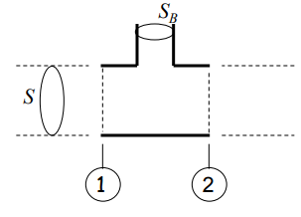
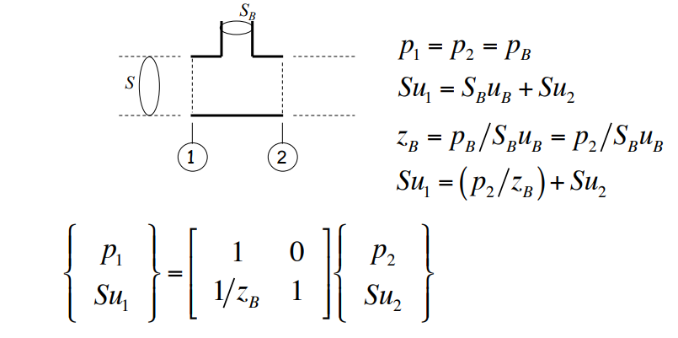
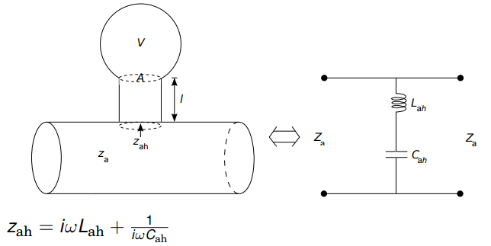
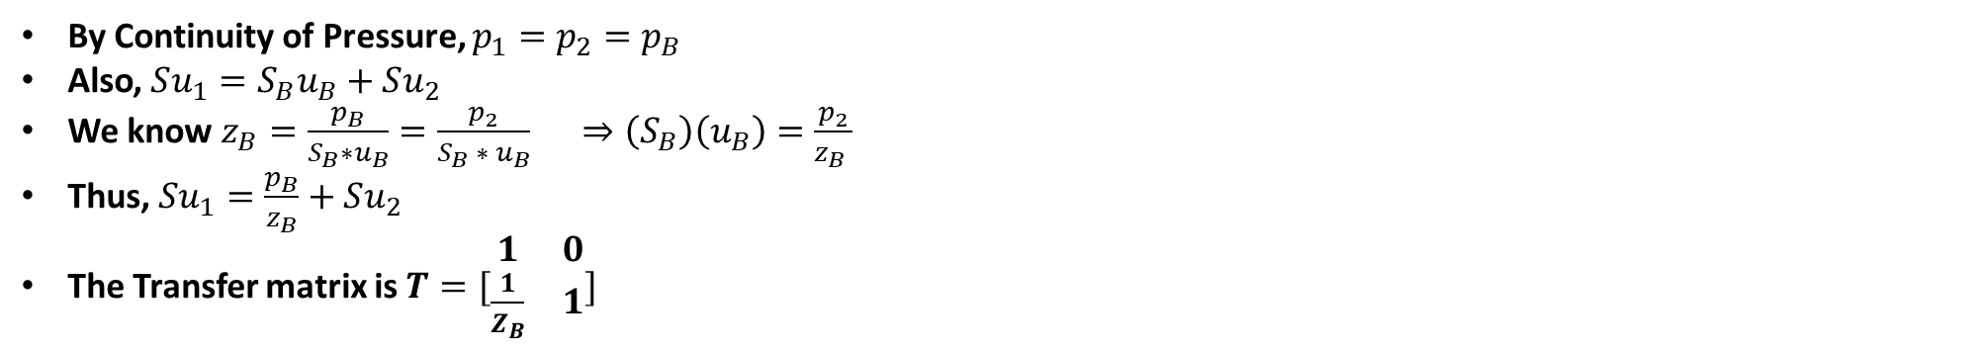
S-Parameters (Side Branch and Helmholtz Resonator)
By Continuity of Pressure, $p_{1}=p_{2}=p_{B}$
Also, $Su_{1}=S_{B}u_{B}+Su_{2}$
We know $z_{B}=\frac{p_{B}}{S_{B}∗u_{B}}=\frac{p_{2}}{S_{B} ∗ u_{B}} ⇒\left(S_{B}\right)\left(u_{B}\right)=\frac{p_{2}}{z_{B} }$
Thus, $Su_{1}=\frac{p_{B}}{z_{B}}+Su_{2}$
The Transfer matrix is $T=[\begin{matrix}1 & 0 \\ \frac{1}{Z_{B}} & 1\end{matrix}]$
To find the transfer matrix for a side branch that is a Helmholtz resonator, just solve for the impedance $Z_{B}$, which is the
impedance of the Helmholtz Resonator
http://web.engr.uky.edu/~dherrin/ME510_Old/Chapter_10_Sound_in_Ducts.pdf

Slide 13
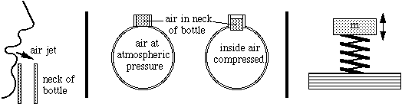
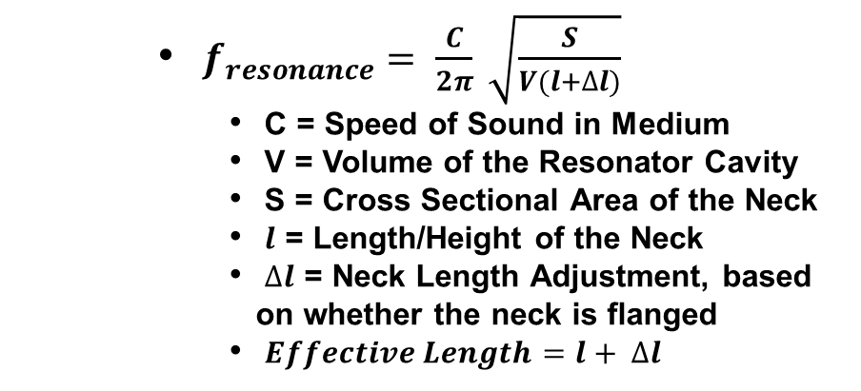
Helmholtz Resonator
What is a Helmholtz Resonator?
A cavity containing a fluid (usually air) with a hole in the cavity, where a neck is attached.
The neck allows flowing fluid to enter the cavity.
This is the phenomena that occurs when blowing over a glass bottle is a result of the bottle being a Helmholtz Resonator.
$f_{resonance}= \frac{C}{2π} \sqrt{\frac{S}{V(l+∆l)}}$
C = Speed of Sound in Medium
V = Volume of the Resonator Cavity
S = Cross Sectional Area of the Neck
$l$ = Length/Height of the Neck
$∆l$ = Neck Length Adjustment, based on whether the neck is flanged
$Effective Length=l+ ∆l$
https://newt.phys.unsw.edu.au/jw/Helmholtz.html

Slide 14
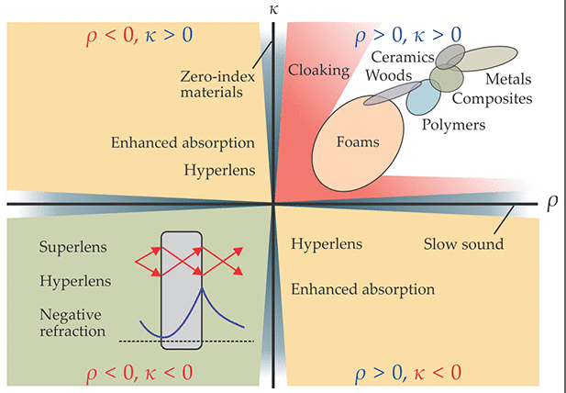
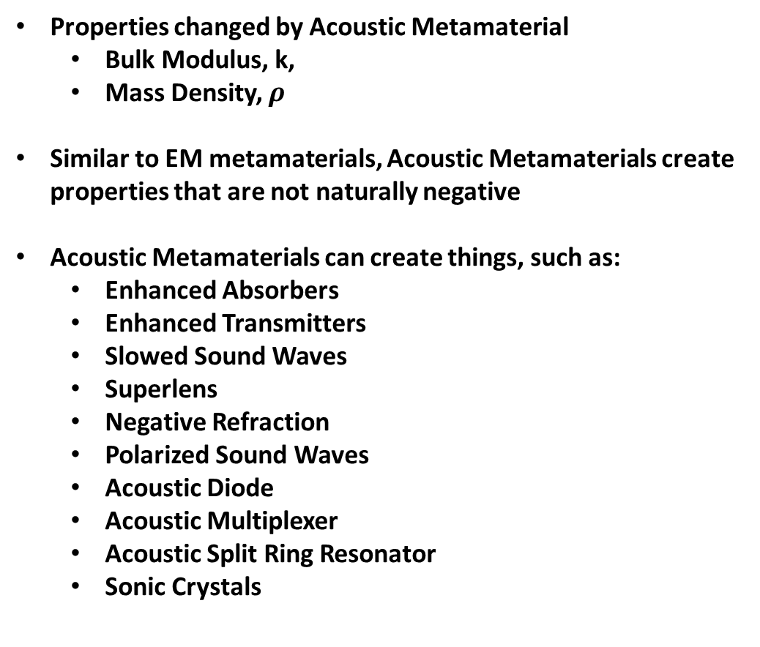
Acoustic Metamaterials
Properties changed by Acoustic Metamaterial
Bulk Modulus, k,
Mass Density, $ρ$
Similar to EM metamaterials, Acoustic Metamaterials create properties that are not naturally negative
Acoustic Metamaterials can create things, such as:
Enhanced Absorbers
Enhanced Transmitters
Slowed Sound Waves
Superlens
Negative Refraction
Polarized Sound Waves
Acoustic Diode
Acoustic Multiplexer
Acoustic Split Ring Resonator
Sonic Crystals
Acoustic Metamaterial Classification
Refraction is the bending of waves when they enter a medium where their speed is different.
https://physicstoday.scitation.org/doi/10.1063/PT.3.3198

Slide 15
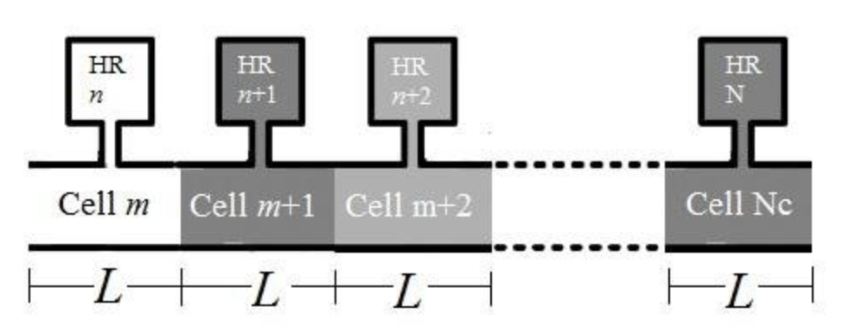
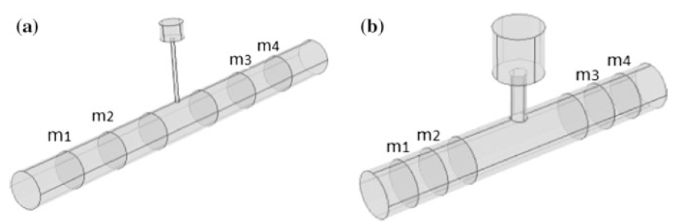
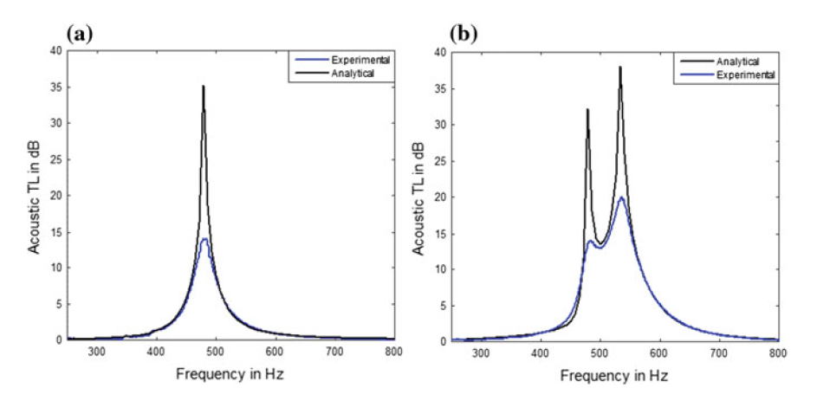
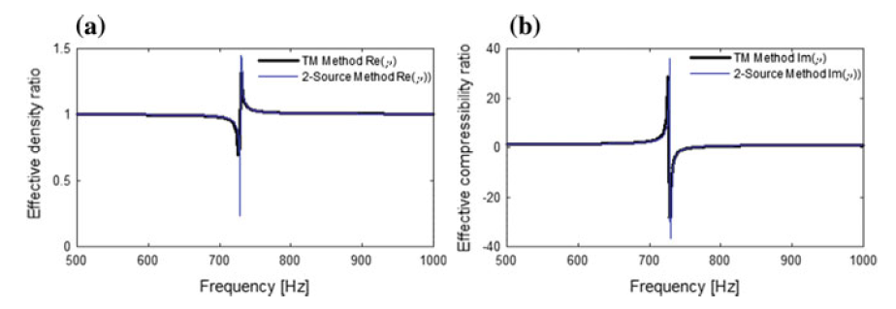
Acoustic Metamaterial Unit Cell (Helmholtz Resonator)
An Acoustic Metamaterial is made up of unit cells containing one or more structures that effect the acoustic wave
One of the most common structures is a Helmholtz Resonator
Each unit cell has an effective bulk modulus and effective mass density.
Each unit cell has there own transmission loss and other properties.
Total of all the unit cells is what makes up the Acoustic Metamaterial
Example: Acoustic Metamaterial Unit Cell Properties
Metamaterial
Non-Metamaterial
Metamaterial
Non-
Metamaterial
Unit Cell
Non-Metamaterial
Metamaterial
https://www.researchgate.net/publication/325104291_Benchmark_Analysis_of_a_Helmholtz_Resonator_for_Estimating_Acoustic_Metamaterial_Properties

Slide 16
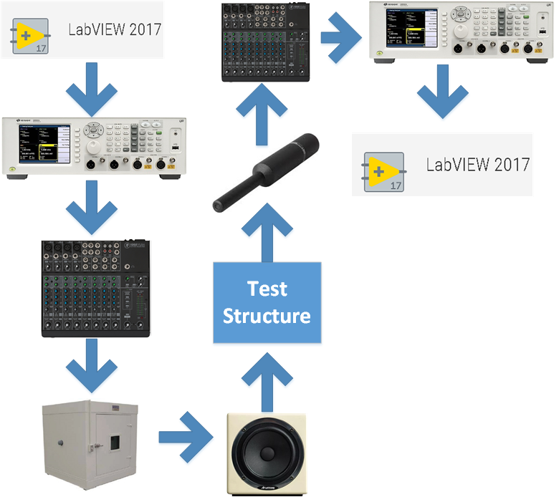
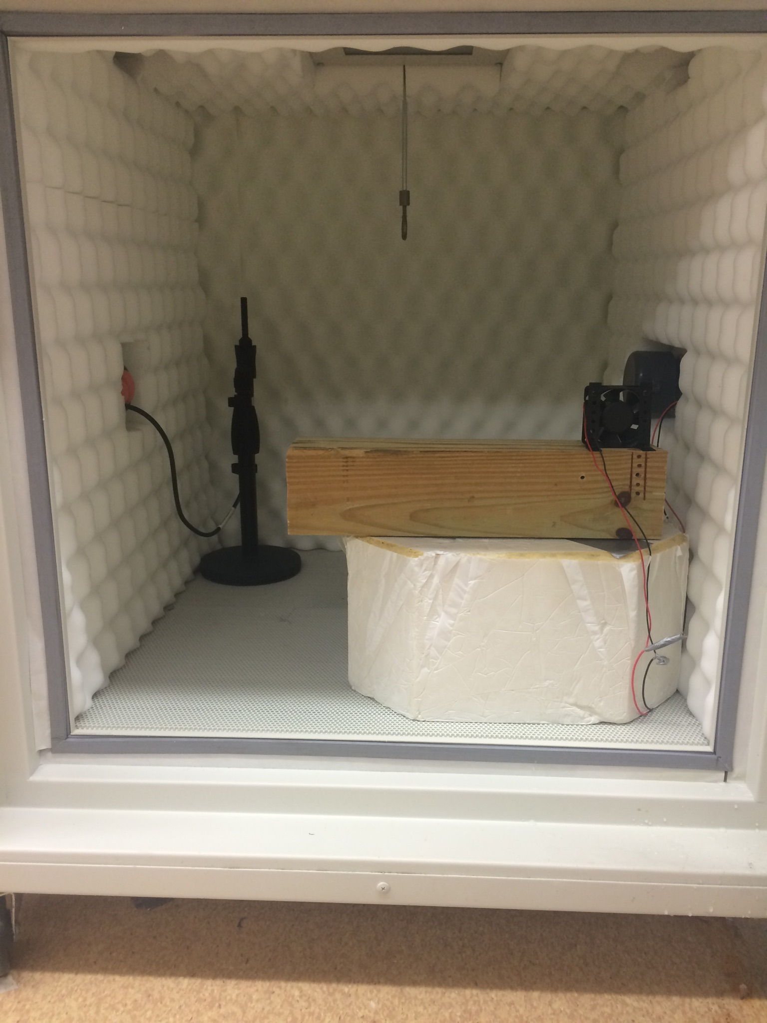
Old Experimental Lab Setup
Drawback to this setup
Hard to measure the Transmission Loss, usually
measured the Insertion Loss, instead.
The REFLECTIONS, especially at lower frequencies

Slide 17
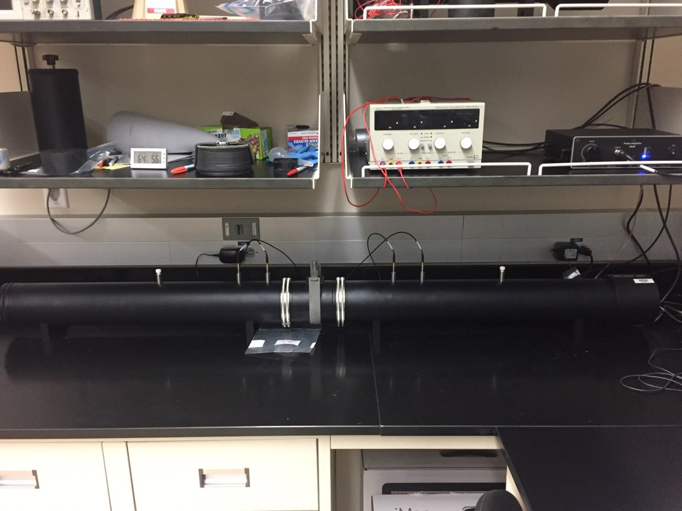
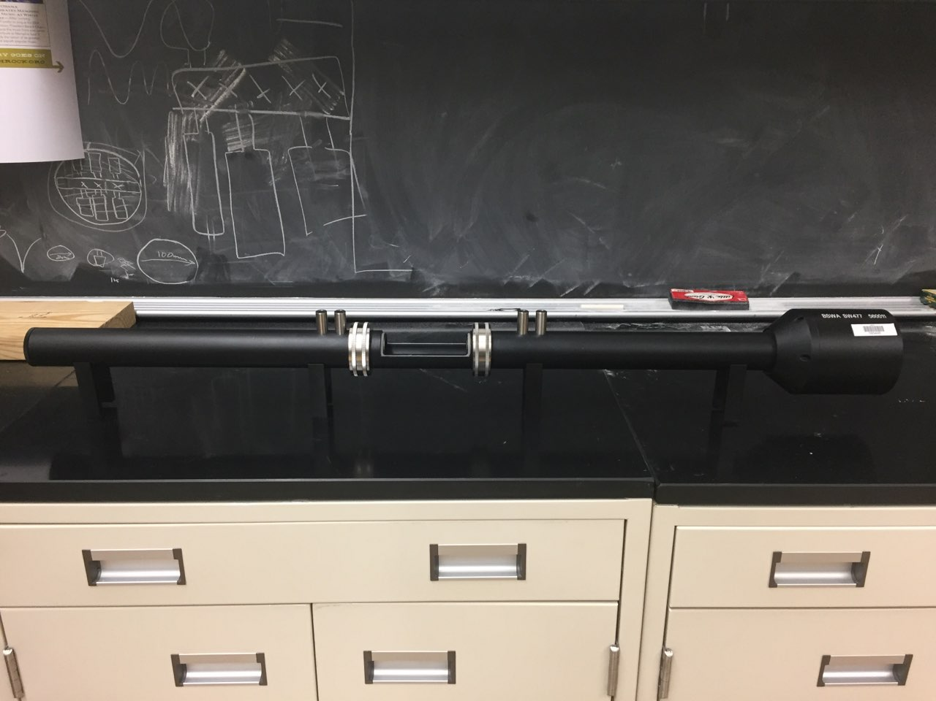
BSWA Impedance Tube
Diameter of Impedance Tube | 100 [mm] | 30 [mm]
Part Number | SW422 | SW477
Operating Frequency | 63[hz] – 1600 [hz] | 1000 [hz] – 6100 [hz]
BSWA SW422 Impedance Tube
Microphones
Speaker
Sample
Holder
BSWA SW477 Impedance Tube
Speaker
From BSWA Impedance Tubes product literature, version 201008

Slide 18
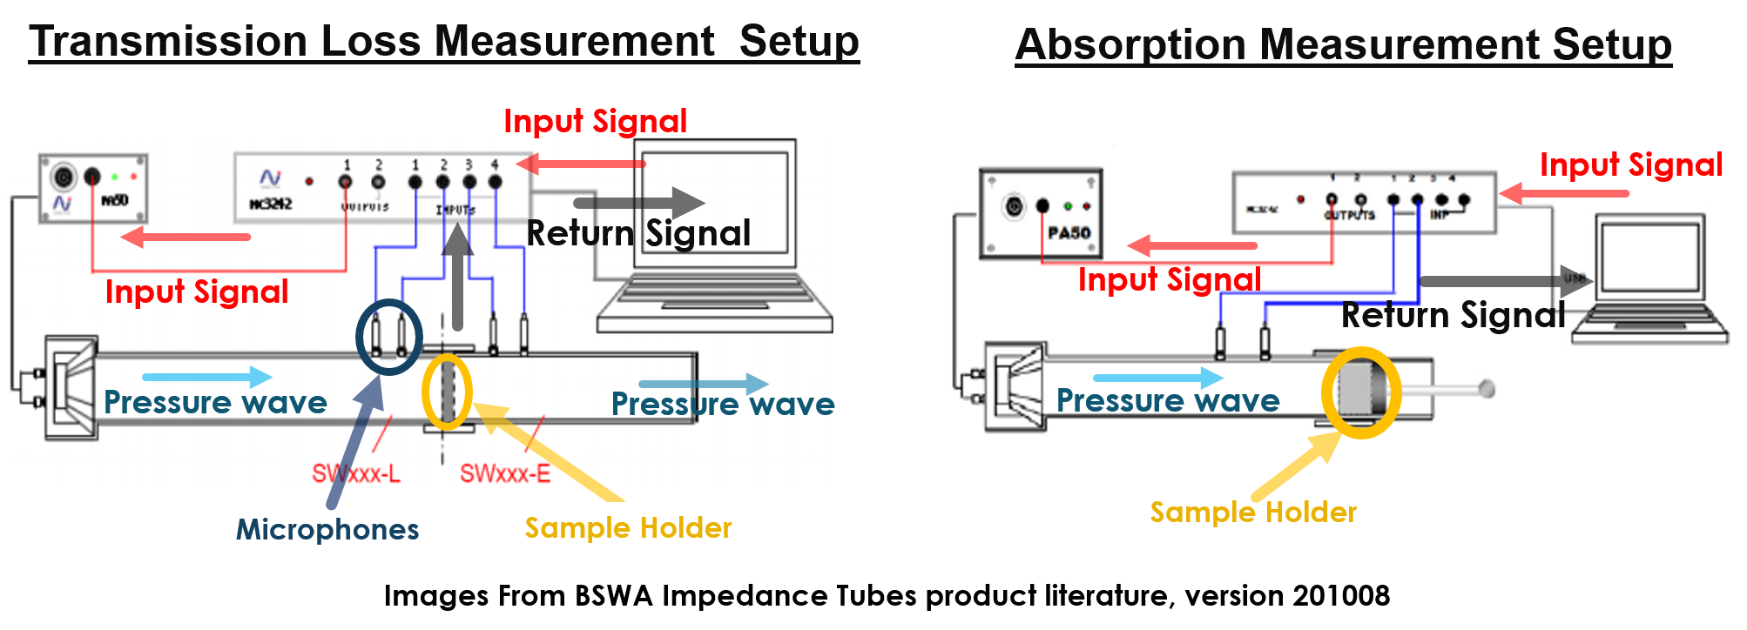
Impedance Tube Measurement Setup
Note: End of tube can be terminated with hard, soft, anechoic, or no boundary, depending on the type of measurement, and following e.g. ASTM procedures.

Slide 19
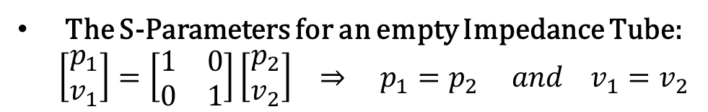
Nothing in the Impedance Tube
The S-Parameters for an empty Impedance Tube:
$$\left[\begin{matrix}p_{1} \\ v_{1}\end{matrix}\right]=\left[\begin{matrix}1 & 0 \\ 0 & 1\end{matrix}\right]\left[\begin{matrix}p_{2} \\ v_{2}\end{matrix}\right] ⇒ p_{1}=p_{2} and v_{1}=v_{2}$$
Transmission Loss

Slide 20
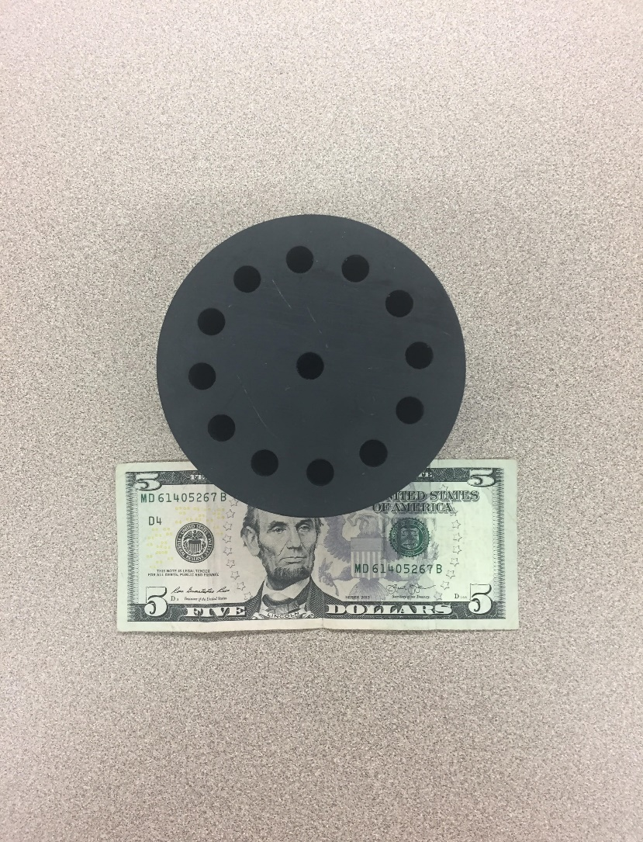
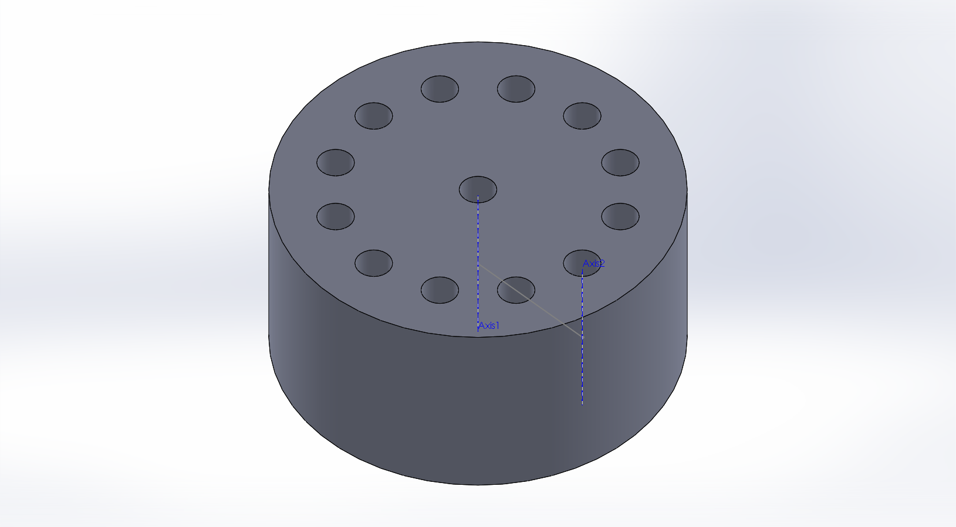
Metamaterial Sample
Metamaterial Sample
Metamaterial Sample Specifications
Face Diameter: 100 [mm]
Depth: 50 [mm]
Resonance Frequency: ~983, ~1025 [Hz]
Sample Shows
TL Peak of 44 dB @ ~1006 [Hz]
Satellite TL Peak of 33 dB @ ~976 [Hz]
100 mm
Transmission Loss of New Sample

